Slide 1
Cottage Physician Wellness Task Force
Chair, James G. Brewer, M.D.
Vice Chair, Anne Rodriguez, M.D.
Catherine Ekwa-Ekoko, M.D.
Alexandra Eidelwein, M.D.

Slide 2
Optimizing Lifestyle for Wellness
6. Projects and Purpose
Sleep
1
6
2
5. Exercise and Diet
2. Mindfulness
5
3
4. Limiting Caffeine,
Alcohol and Screens
4
3. Social Connections
Cottage Physician Wellness Task Force
Notes:
Today’s topic is limiting caffeine, alcohol, and screen time.

Slide 3
Review of Topic 5: Exercise and Diet
Facts
Being physically active for 30 minutes on all or most days reduces risk of heart disease, stroke, high blood pressure, some cancers, and dementia
Exercise has been shown to be an effective adjunct in the treatment of depression
Healthy eating boosts immunity, strengthens bones, supports muscles, helps digestive function, promotes longevity, and reduces risk of heart disease, type 2 diabetes, and some cancers
Challenges
Group reflection and discussion
Tips
Group reflection and discussion
Cottage Physician Wellness Task Force
Notes:
Would anyone like to share their experiences or offer tips to the group on today’s topic?

Slide 4
Topic 6: Projects and Purpose
Facts
Sustained engagement in mentally challenging activities has been shown to improve memory in older adults.
Engaging in creative activities reduces cortisol levels and can lead to lasting improvement in mood
Having a sense of purpose in life reduces risk of stroke, functional physical limitations, cognitive impairment, and mortality
Challenges
Group reflection and discussion
Tips
Group reflection and discussion
Cottage Physician Wellness Task Force
Notes:
Would anyone like to share their experiences or offer tips to the group on today’s topic?

Slide 5
Next Time:
Review of Topic 6 - Projects and Purpose
Reflections & Insights -
Did you try it? Was it helpful?
What challenges did you experience?
How did you overcome them?
Next Up: Projects and Purpose
Cottage Physician Wellness Task Force
Notes:
Next time we will review limiting caffeine, alcohol, and screen time and talk about exercise and diet.

Slide 6
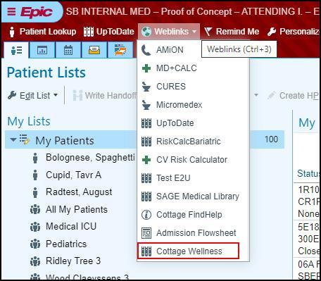
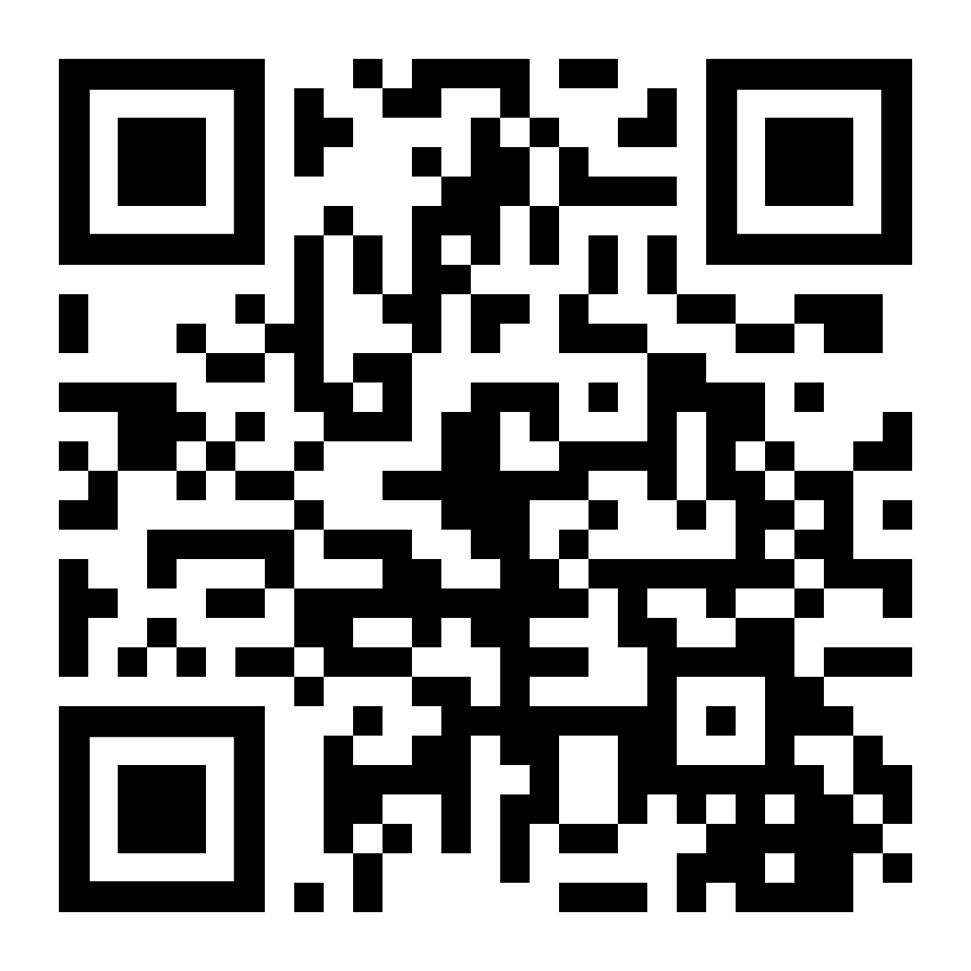
Free Membership to Cottage Physician Wellness Program
Sign up at cottagemdwellness.org, using QR code below or through Epic weblink
Register for discounted Wellness social events and community activities
Have fun making new physician friends and expanding your horizons!

