Slide 1

Cottage Physician Wellness Task Force
Chair, James G. Brewer, M.D.
Vice Chair, Anne Rodriguez, M.D.
Catherine Ekwa-Ekoko, M.D.
Alexandra Eidelwein, M.D.

Slide 2
Optimizing Lifestyle for Wellness
6. Projects and Purpose
Sleep
1
6
2
5. Exercise and Diet
2. Mindfulness
5
3
4. Limiting Caffeine,
Alcohol and Screens
4
3. Social Connections
Cottage Physician Wellness Task Force
Notes:
Today’s topic is limiting caffeine, alcohol, and screen time.

Slide 3

Topic 1: Sleep - Facts, Challenges & Tips
Facts
Sleep deprivation compromises all major physiological systems
Problem solving & creative ability rockets up 15-35% after REM sleep
REM sleep is maximized with a 7-8 hour sleep opportunity
Challenges
Group reflection and discussion
Tips
Group reflection and discussion
Cottage Health Wellness Task Force
Notes:
<Read each fact. Ask group if anyone would like to share their ideas on the topic or offer any tips.>

Slide 4

Next Time:
Review of Topic 1: Sleep
Reflections & Insights -
Did you try it? Was it helpful?
What challenges did you experience?
How did you overcome them?
Next Up: Mindfulness
Cottage Health Wellness Task Force
Notes:
<Tell group that next time we will ask about any changes people made and how it affected them. Then introduce what next topic will be.>

Slide 5

Get involved with Task Force
Help with Wellness Lecture Series
Contact: Catherine Ekwa-Ekoko, M.D.
catekwa@yahoo.com
Plan Social Event Calendar
Contact: Alexandra Eidelwein, M.D.
aeidelwein@sbch.org
Join the Task Force.
Meeting every 2 months, 12:15, Towbes Conf. Rm,
beginning May 30
Contact: James Brewer, M.D.
saves9@yahoo.com
Cottage Health Wellness Task Force
Notes:
Here is contact information if anyone would like to help with the most fun task force ever <Leave slide up for at least 30 sec>

Slide 6
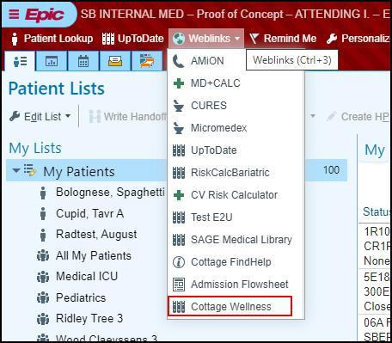

Free Membership to Cottage Physician Wellness Program
Sign up at cottagemdwellness.org, using QR code below or through Epic weblink
Register for discounted Wellness social events and community activities
Have fun making new physician friends and expanding your horizons!

