Slide 1

Cottage Physician Wellness Task Force
Chair, James G. Brewer, M.D.
Vice Chair, Anne Rodriguez, M.D.
Catherine Ekwa-Ekoko, M.D.
Alexandra Eidelwein, M.D.

Slide 2
Optimizing Lifestyle for Wellness
6. Projects and Purpose
Sleep
1
6
2
5. Exercise and Diet
2. Mindfulness
5
3
4. Limiting Caffeine,
Alcohol and Screens
4
3. Social Connections
Cottage Physician Wellness Task Force
Notes:
Today’s topic is limiting caffeine, alcohol, and screen time.

Slide 3

Review of Topic 1: Sleep - Facts, Challenges & Tips
Facts
Sleep deprivation compromises all major physiological systems
Problem solving & creative ability rockets up 15-35% after REM sleep
REM sleep is maximized with a 7-8 hour sleep opportunity
Challenges
Group reflection and discussion
Tips
Group reflection and discussion
Cottage Health Wellness Task Force
Notes:
First let’s review topic from last time. Has anyone made any changes to their sleep routine or have any other tips on sleep?

Slide 4
Topic 2: Mindfulness - Facts, Challenges & Tips
Facts
Mindfulness is paying attention to the present moment without judgement, including bodily sensations, thoughts, and feelings
Leads to higher presence with patients and families
Allows for intentional responsiveness rather than impulsive reactivity
Studies show up to 60% reduction in stress levels among hospital staff
Challenges
Group reflection and discussion
Tips
Group reflection and discussion
Cottage Health Wellness Task Force
Notes:
<Read facts on mindfulness> Does anyone want to share their experience with mindfulness or offer tips to the group on ways to incorporate it into your life?

Slide 5

Next Time:
Review of Topic 2 - Mindfulness
Reflections & Insights -
Did you try it? Was it helpful?
What challenges did you experience?
How did you overcome them?
Next Up: Social Connections
Cottage Health Wellness Task Force
Notes:
Next time we will review Mindfulness and talk about Social Connections.

Slide 6
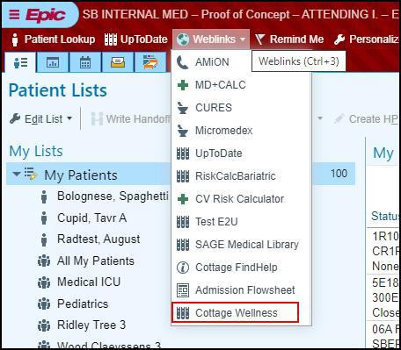

Free Membership to Cottage Physician Wellness Program
Sign up at cottagemdwellness.org, using QR code below or through Epic weblink
Register for discounted Wellness social events and community activities
Have fun making new physician friends and expanding your horizons!

